Slide 1


3rd year exchange,
Research, and Education in Chemical Engineering at EPFL
Kumar Varoon Agrawal
Chemical engineering exchange coordinator

Slide 2

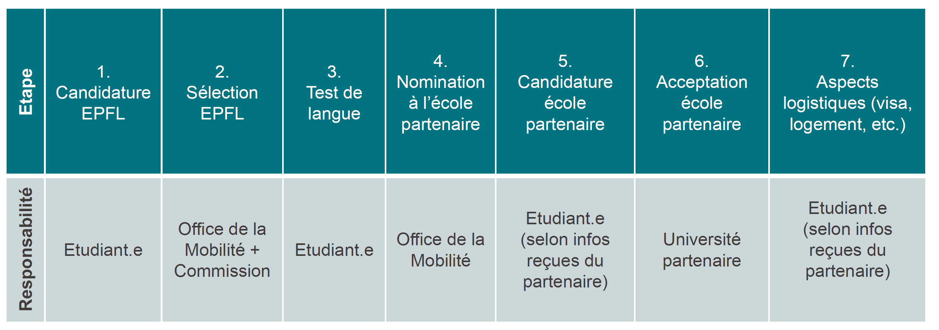
3rd year Exchange in Chemical Engineering
Process is the same as for chemistry
Requirements: Exchange in 3rd year Bachelor
Outside Europe : ≥ 5.00 GPA in the propaedeutic year
In Europe : ≥4.50 GPA in propaedeutic year
Must obtain the 60 credits of the 2nd year Bachelor
Steps of the procedure:
2

Slide 3
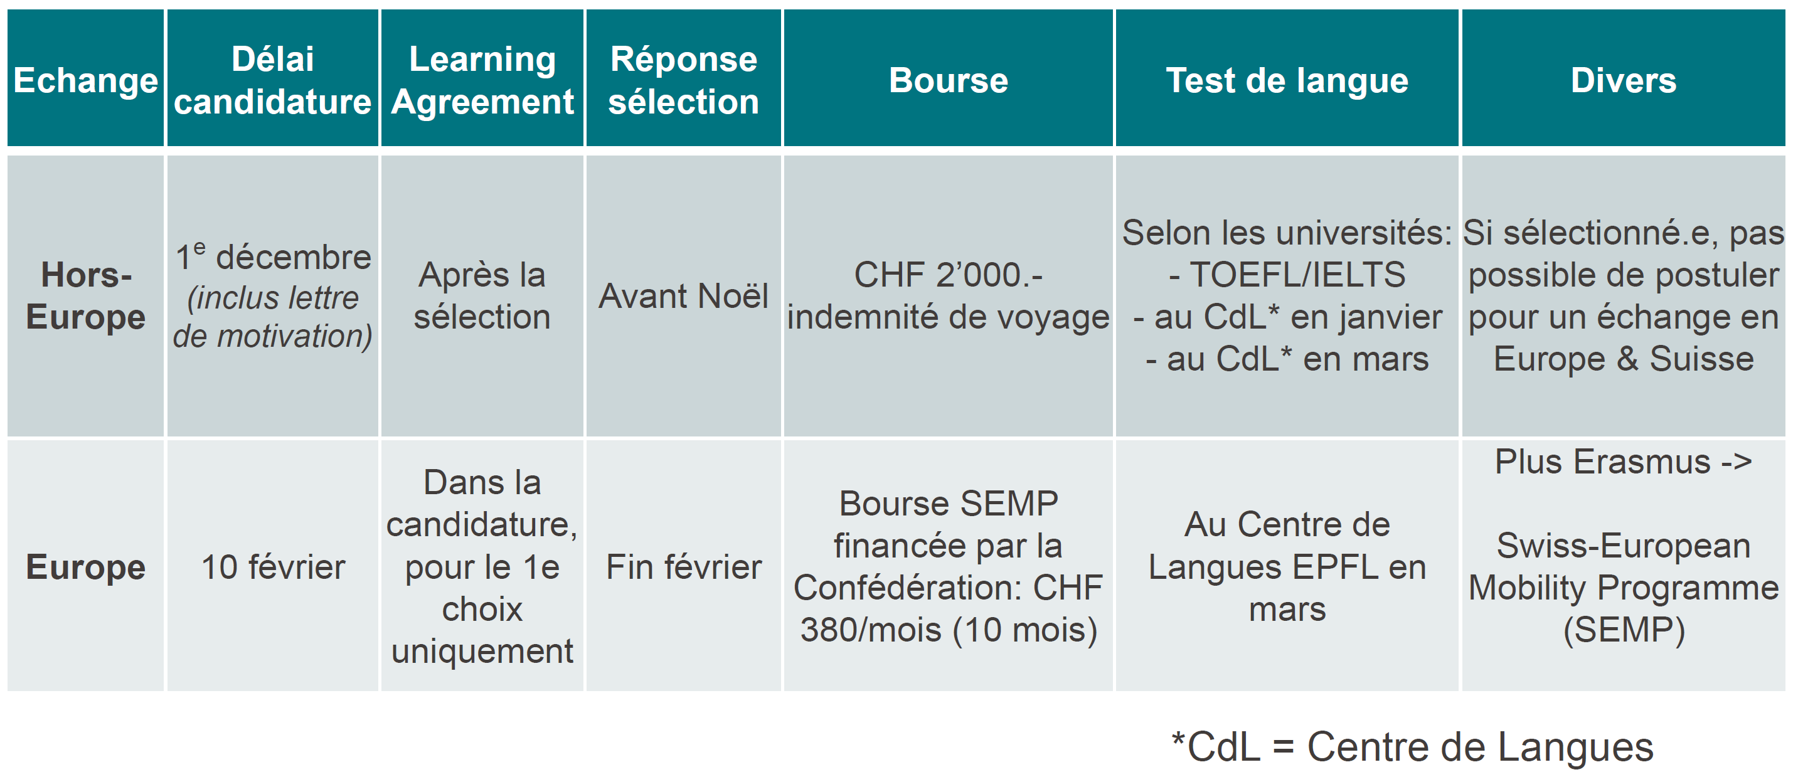
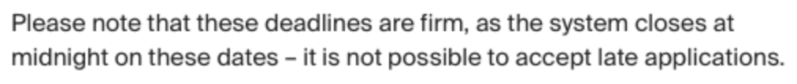
3rd year Exchange in Chemical Engineering
Process is the same as for chemistry
You must make an appointment with me by Feb 3rd!
3

Slide 4
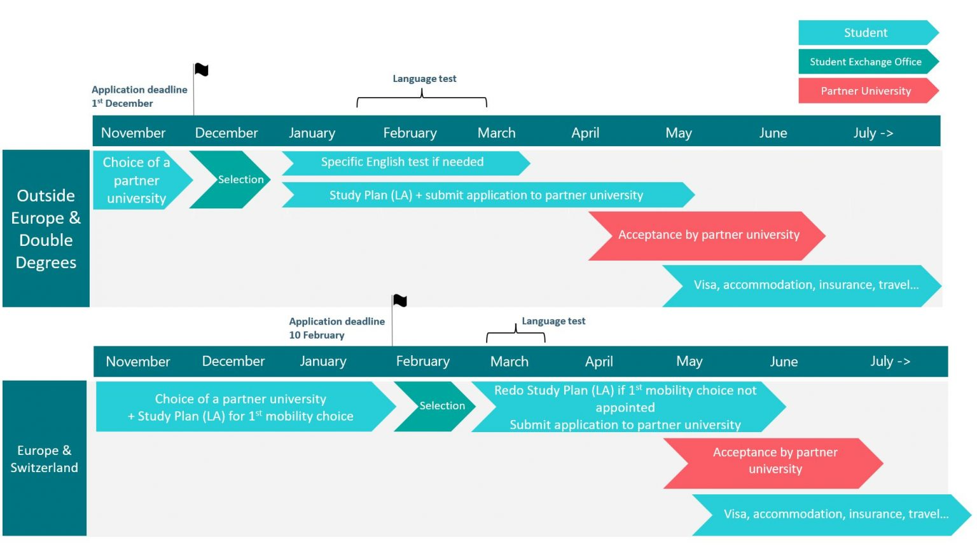
3rd year Exchange in Chemical Engineering
Process is the same as for chemistry
You must make an appointment with me by Feb 3rd!
4

Slide 5
3rd year Exchange in Chemical Engineering
Process is the same as for chemistry
Learning Agreement (plan de cours):
Study the study plan of the 3rd year Chemical Engineering at EPFL
Study the course offerings of the host universities that interest you (should be at least 60 ECTS).
The course outline must always be approved by me.
We cannot guarantee access to the courses required by your section at your host university. It is your responsibility to verify access to these courses before departure.
Application form:
In your portal in IS Academia ("exchange application" tab)
Follow the steps on the website: epfl.ch/education/international/fr/partir-etudier-a-l-etranger/echange-
bachelor/candidature-delais/
5

Slide 6
3rd year Exchange in Chemical Engineering
Process is the same as for chemistry
Offices/people involved:
Academic Exchange Advisor: course-related issues (approval of course list and changes, validation of credits upon return from exchange).
Office de la Mobilité: administrative issues (requirements, selection, application to partner universities, scholarships).
Important points:
EPFL cannot guarantee access to courses required by the sections in the host universities and that it is the
student's responsibility to check access to these courses before departure. It is possible that the student will
have to cancel the exchange if he/she does not find the required equivalences.
Students must take the majority of courses in the faculty in which they are registered. In some universities it is not possible to take courses in different faculties (UPC Barcelona, UPM Madrid, TU Delft, UBC Vancouver,...).
Students must take SHS courses during their exchange. If the host university does not offer the possibility of
such courses, students must replace them with engineering courses.
Language courses taken during the exchange are not recognized and credited by EPFL.
There is no block system for subjects acquired during the exchange. Each subject must be passed.
The grades obtained during the exchange are not recorded in the EPFL report card. Consequently, the overall
average of the Bachelor's degree is calculated solely on the results of the propaedeutic year and the 2nd year Bachelor's degree.
Access to computer science courses is increasingly limited in institutions outside Europe.
6

Slide 7
What is Chemical Engineering?
You have only a small introduction up to now….
Mathematics: Analysis and linear algebra
Year 1:
Physics: General physics I&II
Advanced general Chemistry I&II
Bloc 2
General physics: electromagnetism
Interfacial chemistry
Mathematical methods in chemistry
Quantum chemistry
Spectroscopy
Statistical thermodynamics
Practical work in Chemistry I&II
Bloc 1
Chemistry of elements s and p
Chimie analytique expérimentale
Chimie organique, TP
Coordination chemistry
Fonctions et réactions organiques I
Méthodes de séparation analytiques
Organometallic chemistry
Year 2:
Bloc 3
Biochimie
Introduction to chemical engineering
Chemical Engineering & Energy TP
Introduction to transport phenomena
Probabilités et statistique
7

